Slide 1
Bayesian model averaging
In Python. And fast. With JAX.
Max Hinne
Uncertainty in Complex Systems lab

Slide 2
The program for today
11:15 – 12:15: Background lecture on Bayesian model averaging
12:15 – 13:00: Food!
13:00 – 15:30: Hands-on workshop
13:00 – 13:15: Short intro to materials (Python notebook, JAX)
13:15 – 14:00: Hands-on self-paced tutorial
14:00 – 14:15: Food! (well, coffee)
14:15 – 15:00: Hands-on self-paced tutorial
15:00 – 15:30: Wrap-up and Q&A

Slide 3
Part 1: the conceptual
And a tiny bit of math

Slide 4





What is Bayesian model averaging? (and why do we care?)

Slide 5
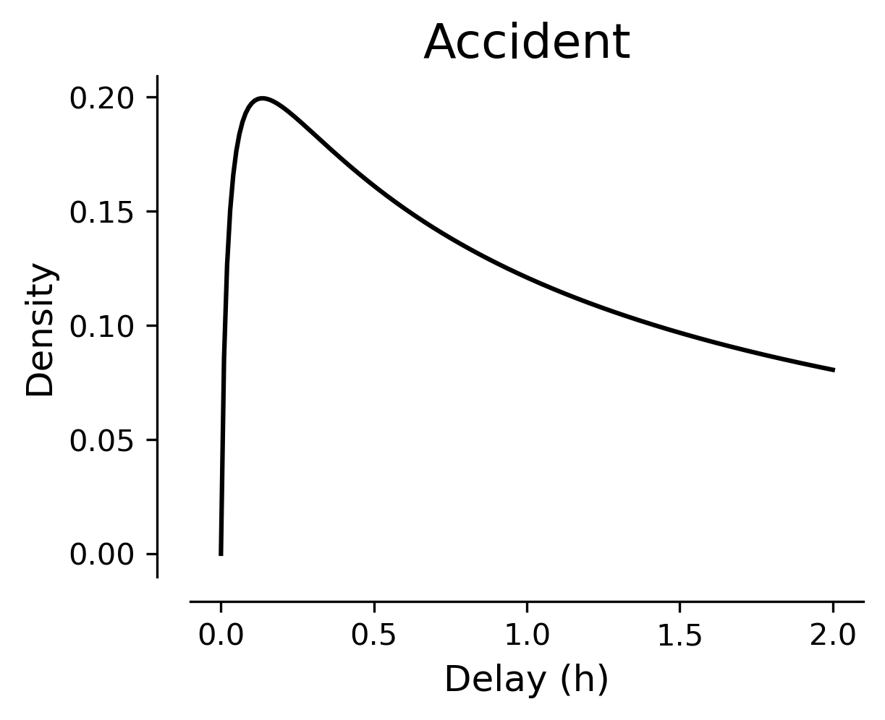
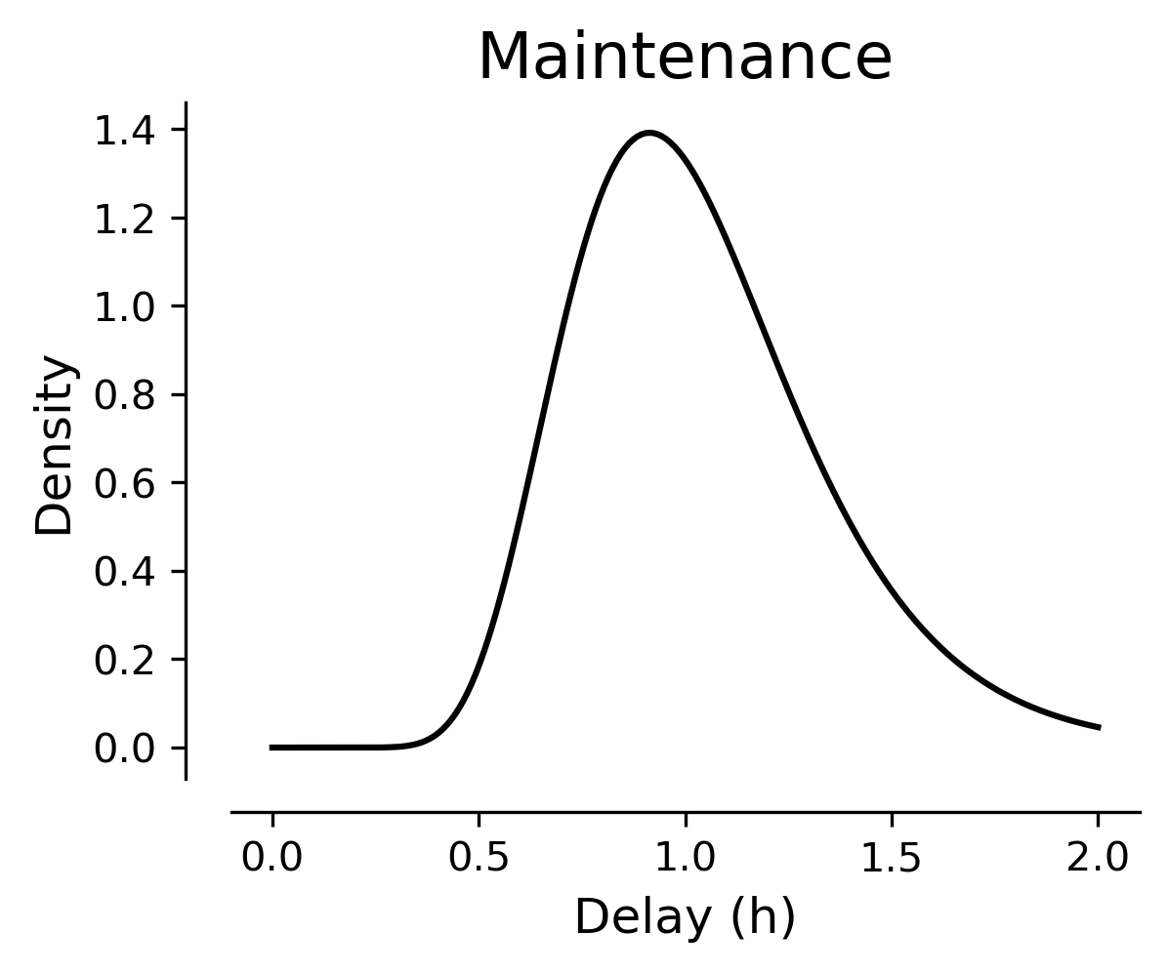
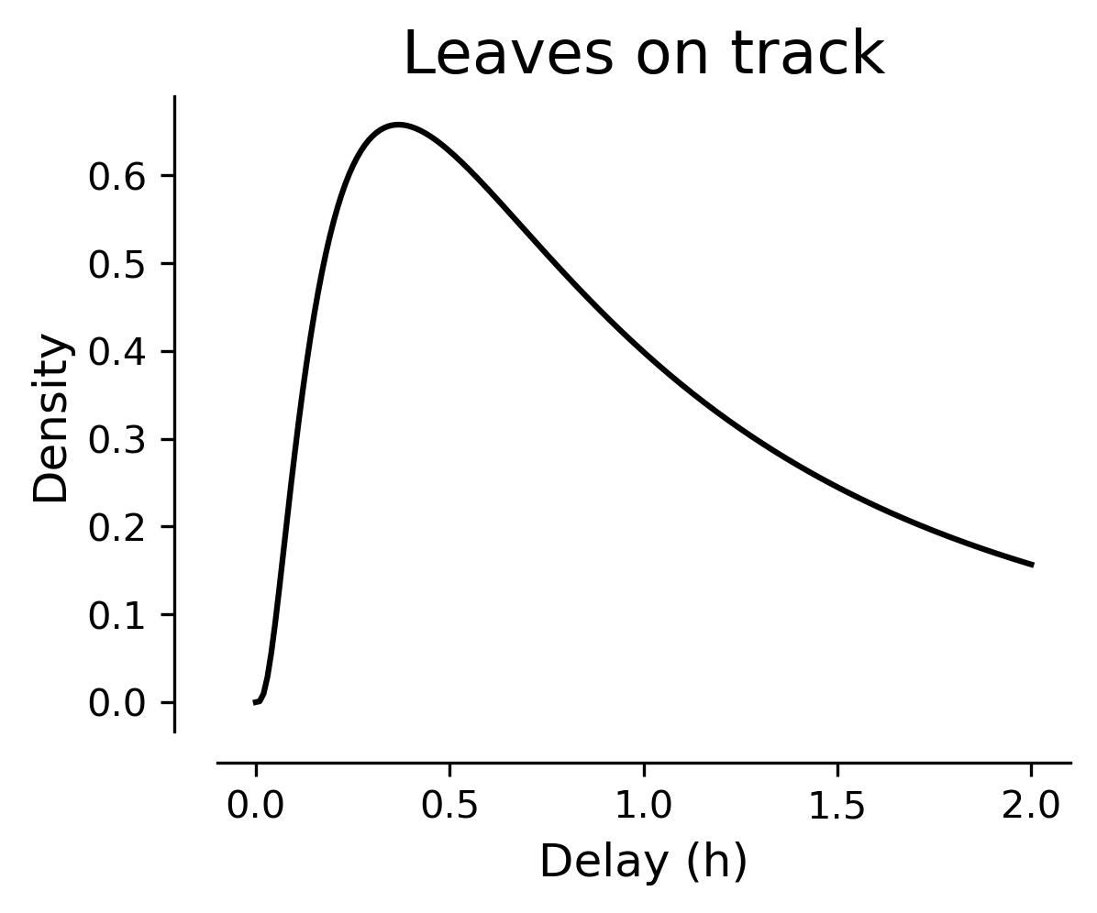
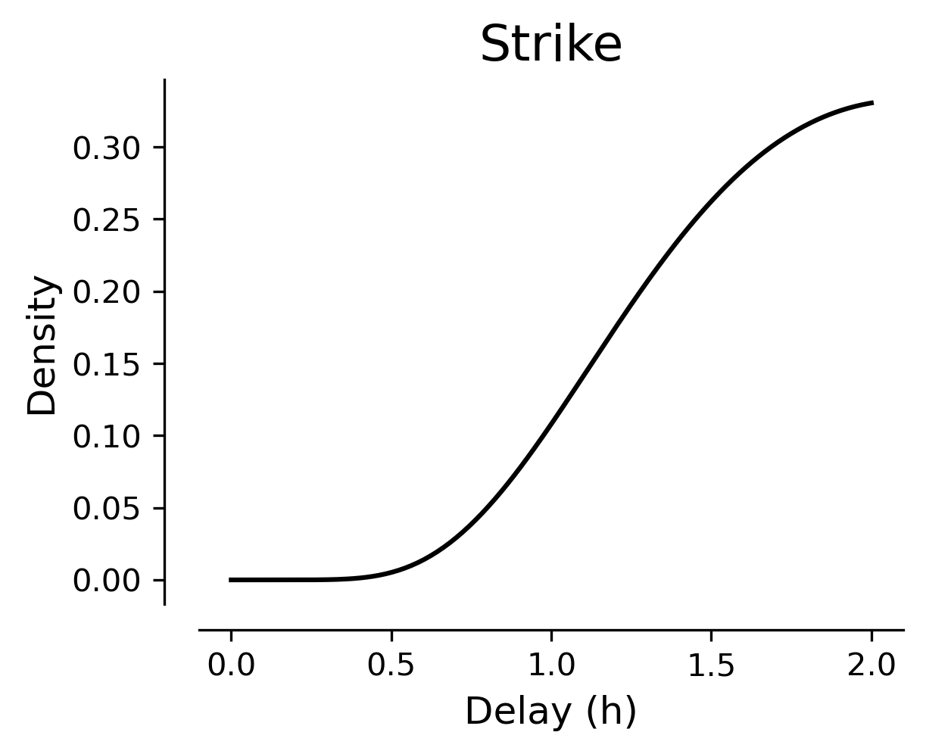

What is Bayesian model averaging? (and why do we care?)
$$\text{delay}∼p(\text{delay}∣\text{scenario})$$

Slide 6
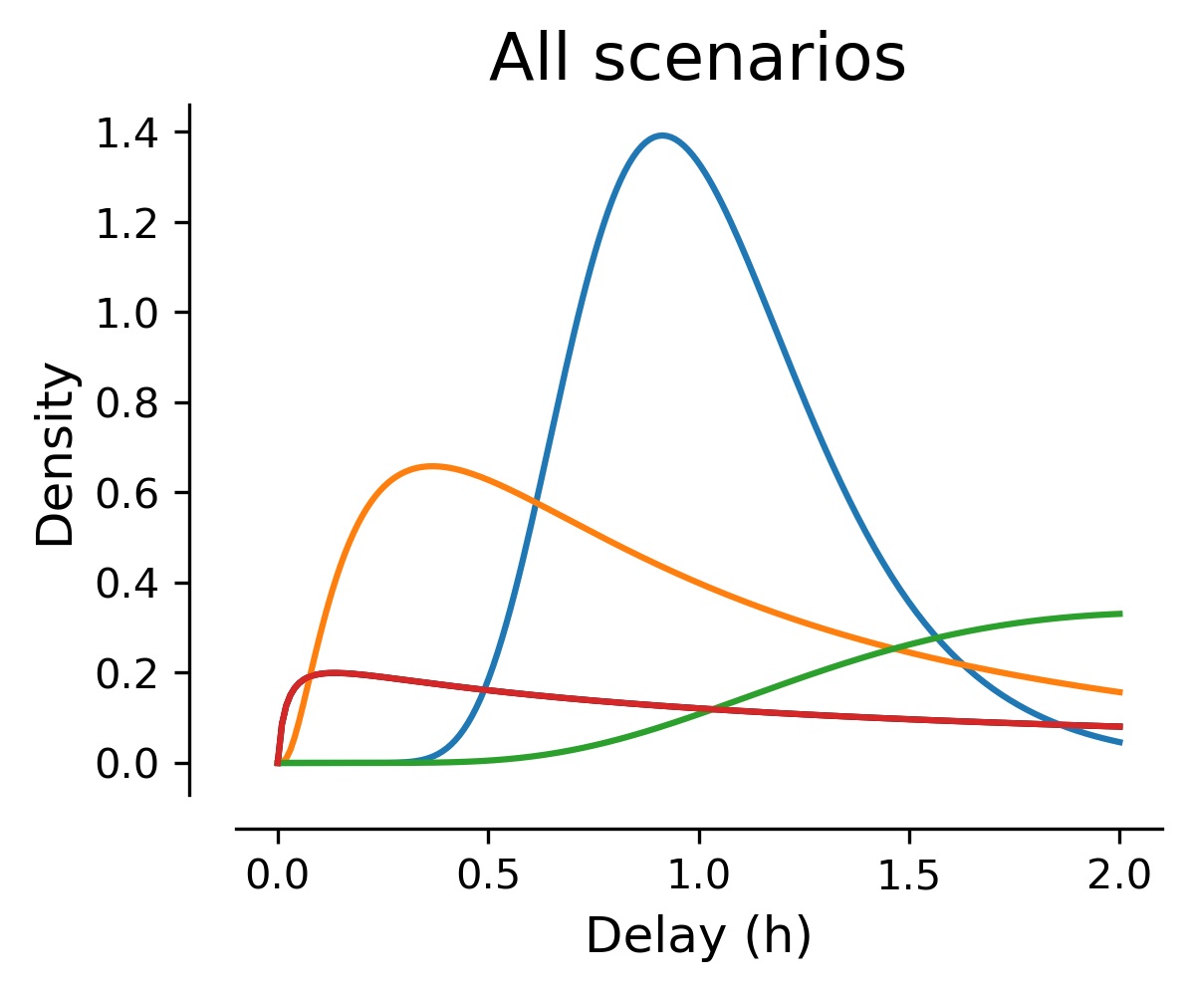
What is Bayesian model averaging? (and why do we care?)

Slide 7
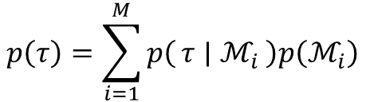




What is Bayesian model averaging? (and why do we care?)
$$p\left(τ ∣ ℳ_{3}\right)$$
$$p\left(τ ∣ ℳ_{1}\right)$$
$$p\left(τ ∣ ℳ_{4}\right)$$
$$p\left(τ ∣ ℳ_{2}\right)$$
$$p\left(τ\right)=\sum_{i=1}^{M}{p\left(τ ∣ ℳ_{i}\right)p\left(ℳ_{i}\right)}$$
Notes:
Follows from the Law of Total Probability

Slide 8
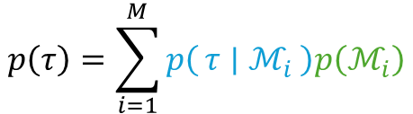
The idea of Bayesian model averaging (BMA)
Our models are often about predictions/quantities.
Different models (= hypotheses) generate different predictions.
We might not know which model is true/best.
This might not even exist!
Or we don’t even care!
BMA is the prediction that averages over the model uncertainty.
$$p\left(τ\right)=\sum_{i=1}^{M}{p\left(τ ∣ ℳ_{i}\right)p\left(ℳ_{i}\right)}$$

Slide 9
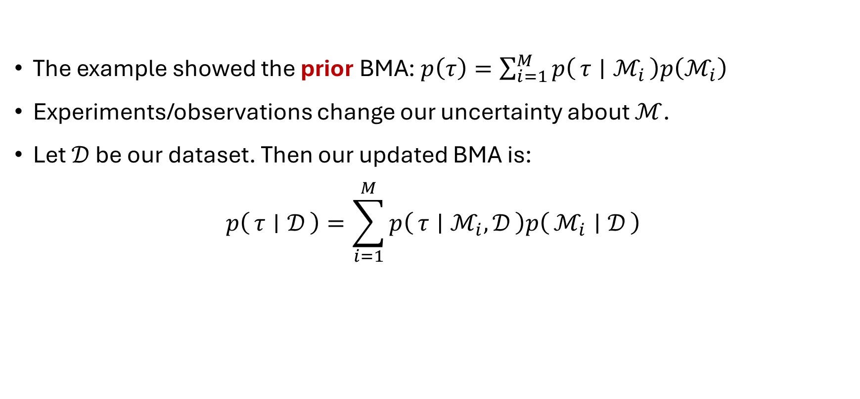
The prior/posterior BMA
The example showed the prior BMA: $p\left(τ\right)=\sum_{i=1}^{M}{p\left(τ ∣ ℳ_{i}\right)p\left(ℳ_{i}\right)}$
Experiments/observations change our uncertainty about $ℳ$.
Let $𝒟$ be our dataset. Then our updated BMA is:
$$p\left(τ ∣ 𝒟\right)=\sum_{i=1}^{M}{p\left(τ ∣ ℳ_{i},𝒟\right)p\left(ℳ_{i} ∣ 𝒟\right)}$$

Slide 10
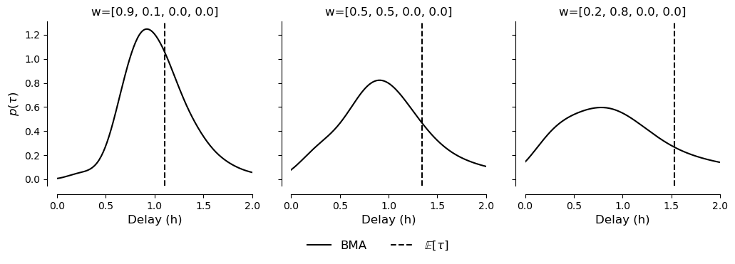

Back to the train
Let our different model uncertainties be (for example):
$w_{1}=\left(0.9, 0.1, 0.0, 0.0\right), w_{2}=\left(0.5, 0.5, 0.0, 0.0\right), w_{3}=\left(0.2, 0.8, 0.0, 0.0\right)$
This changes the BMA $p\left(τ\right)$ (and derived quantities like its expectation) drastically:

Slide 11
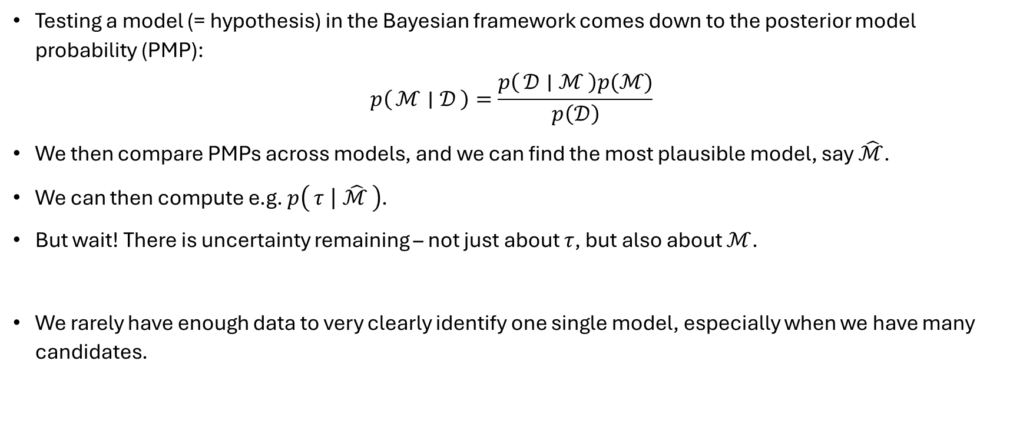
The argument for BMA
Testing a model (= hypothesis) in the Bayesian framework comes down to the posterior model probability (PMP):
$$p\left(ℳ ∣ 𝒟\right)=\frac{p\left(𝒟 ∣ ℳ\right)p(ℳ)}{p\left(𝒟\right)}$$
We then compare PMPs across models, and we can find the most plausible model, say $\hat{ℳ}$.
We can then compute e.g. $p\left(τ ∣ \hat{ℳ}\right)$.
But wait! There is uncertainty remaining – not just about $τ$, but also about $ℳ$.
We rarely have enough data to very clearly identify one single model, especially when we have many candidates.

Slide 12
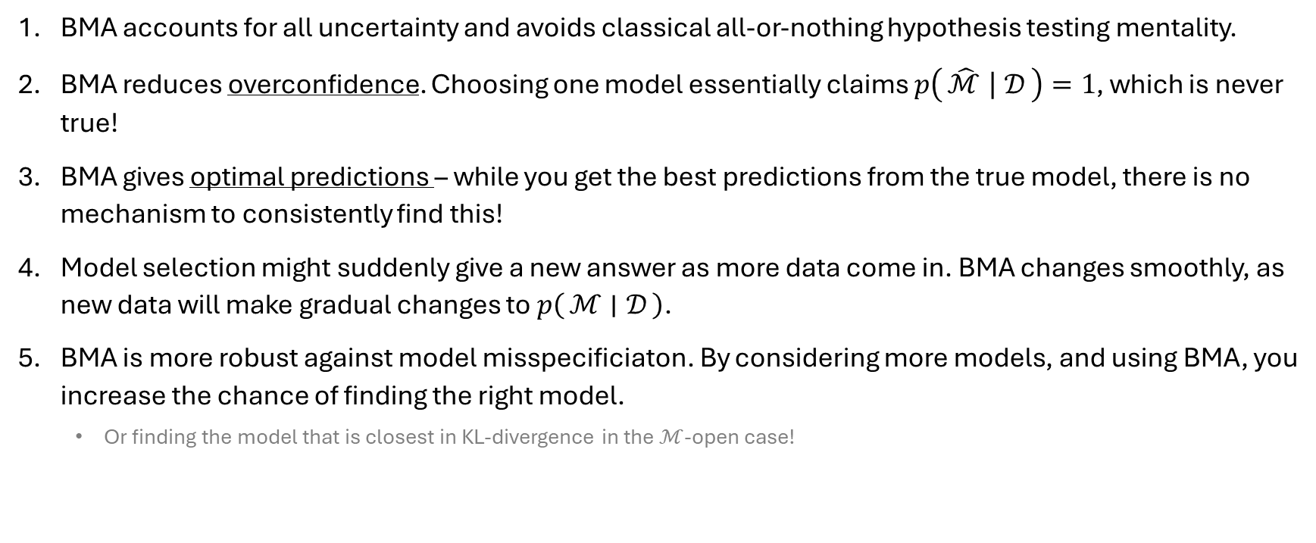
Advantages of model averaging vs selection
BMA accounts for all uncertainty and avoids classical all-or-nothing hypothesis testing mentality.
BMA reduces overconfidence. Choosing one model essentially claims $p\left(\hat{ℳ} ∣ 𝒟\right)=1$, which is never true!
BMA gives optimal predictions – while you get the best predictions from the true model, there is no mechanism to consistently find this!
Model selection might suddenly give a new answer as more data come in. BMA changes smoothly, as new data will make gradual changes to $p\left(ℳ ∣ 𝒟\right)$.
BMA is more robust against model misspecificiaton. By considering more models, and using BMA, you increase the chance of finding the right model.
Or finding the model that is closest in KL-divergence in the $ℳ$-open case!

Slide 13

When to (not) use BMA
For prediction/estimation where you don’t care about which model was ‘true’.
Here $ℳ$ becomes a nuisance parameter that is summed out.
If you want to know which model best describes a process, the model is the focus!
This is not when you want to use BMA, but model selection/comparison!

Slide 14
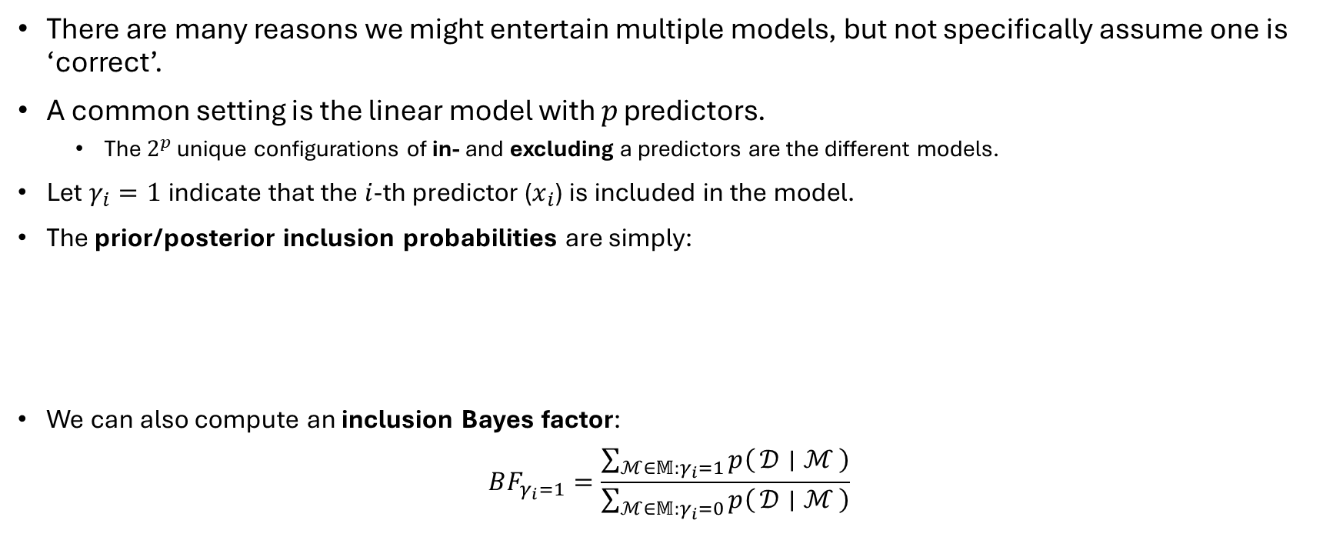
A common scenario – inclusion probabilities
There are many reasons we might entertain multiple models, but not specifically assume one is ‘correct’.
A common setting is the linear model with $p$ predictors.
The $2^{p}$ unique configurations of in- and excluding a predictors are the different models.
Let $γ_{i}=1$ indicate that the $i$-th predictor ($x_{i}$) is included in the model.
The prior/posterior inclusion probabilities are simply:
We can also compute an inclusion Bayes factor:
$$BF_{γ_{i}=1}=\frac{\sum_{ℳ∈𝕄:γ_{i}=1}{p\left(𝒟 ∣ ℳ\right)}}{\sum_{ℳ∈𝕄:γ_{i}=0}{p\left(𝒟 ∣ ℳ\right)}}$$
$$p\left(γ_{i}=1\right)=\sum_{ℳ∈𝕄:γ_{i}=1}{p\left(ℳ\right)}$$ | and | $$p\left(γ_{i}=1∣𝒟\right)=\sum_{ℳ∈𝕄:γ_{i}=1}{p\left(ℳ∣𝒟\right)}$$

Slide 15
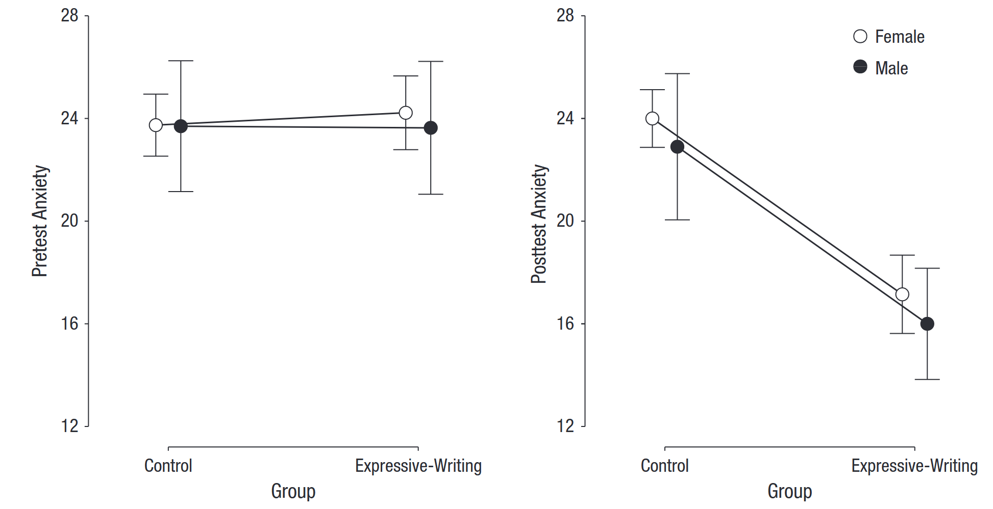
A very simple example
Shen et al.: Does expressive writing reduce test anxiety for high school students?
Predictors/covariates: group (intervention / control), gender, pre-test anxiety score
Target: post-test anxiety score.
Analysis: Bayesian ANCOVA.
Which predictors are relevant? → Multiple models
BMA for finding inclusion probabilities – how important are these predictors, regardless of specific model choice?

Slide 16
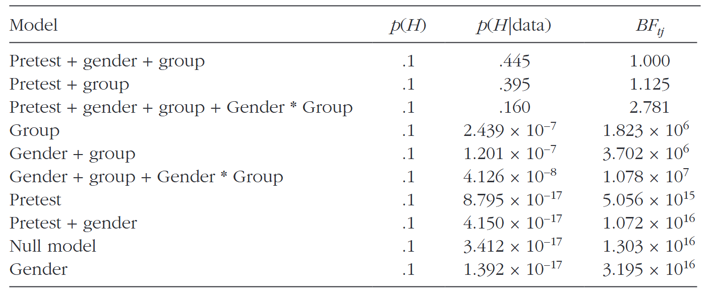
A very simple example

Slide 17
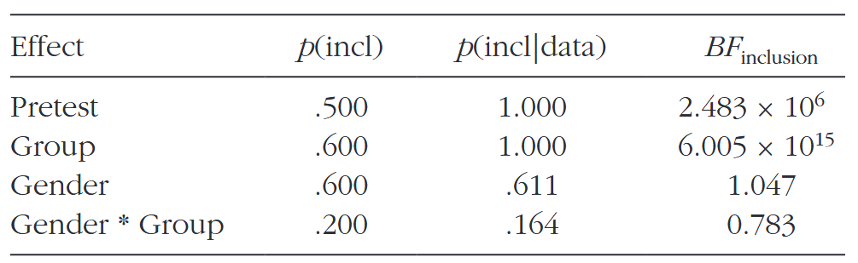
A very simple example
Inclusion Bayes factors tell us much more than if we had selected one ‘best’ model.
More on this in the practice material later!

Slide 18
Part II: The pragmatic
And a whole lot of code

Slide 19

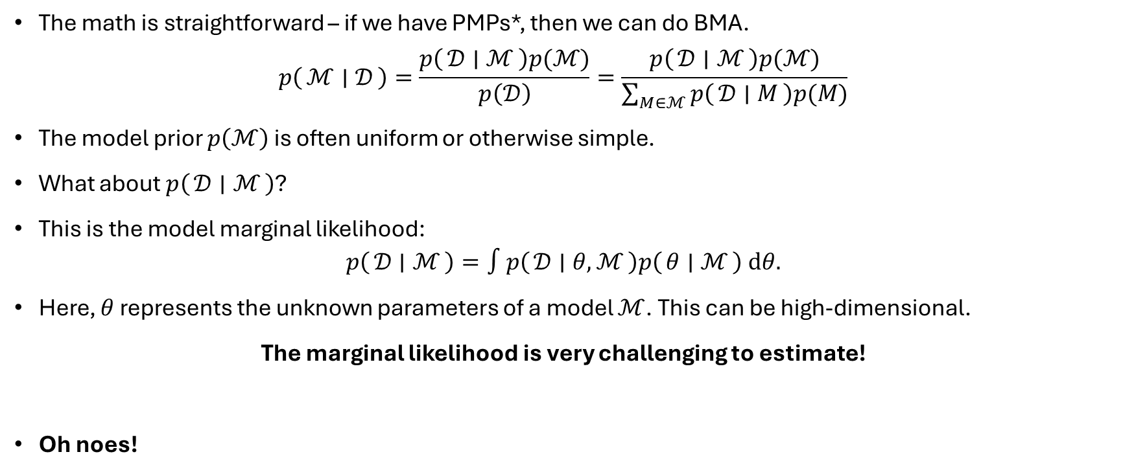
The challenges for BMA
The math is straightforward – if we have PMPs*, then we can do BMA.
$$p\left(ℳ ∣ 𝒟\right)=\frac{p\left(𝒟 ∣ ℳ\right)p(ℳ)}{p\left(𝒟\right)}=\frac{p\left(𝒟 ∣ ℳ\right)p(ℳ)}{\sum_{M∈ℳ}{p\left(𝒟 ∣ M\right)p(M)}}$$
The model prior $p\left(ℳ\right)$ is often uniform or otherwise simple.
What about $p\left(𝒟 ∣ ℳ\right)$?
This is the model marginal likelihood:
$$p\left(𝒟 ∣ ℳ\right)=∫p\left(𝒟 ∣ θ,ℳ\right)p\left(θ ∣ ℳ\right) dθ.$$
Here, $θ$ represents the unknown parameters of a model $ℳ$. This can be high-dimensional.
The marginal likelihood is very challenging to estimate!
Oh noes!
*: posterior model probabilities

Slide 20


BMA in Python using JAX & bamojax
For different specific model sets (linear models, Gaussian graphical models), BMA tools are readily available.
There is no generic toolbox that always works.
If no better solutions exist, we approximate the marginal likelihood for each model.
Today we’ll explore one framework to do so: bamojax (Hinne, 2025; JOSS)
Bamojax uses the Python JAX framework by Google Deepmind for fast and GPU-able code.
It implements:
Importance sampling
The Laplace approximation
Sequential Monte Carlo (Hinne, 2025, Beh. Res. Meth.)
Bridge sampling (Meng & Wong, 1996, Stat. Sin.; Gronau et al., 2017, J. Math. Psych.)
The THAMES estimator (Metodiev et al., 2025, Bayes. Ana.)

Slide 21
Coding setup
Time to get to work!

Slide 22
Getting started
We experiment with implementing BMA for increasingly relevant models.
All materials for today are available on https://github.com/UncertaintyInComplexSystems/BMA_Workshop.
Note: Installing JAX locally (and having it work with your GPU) takes some effort. Quick solution: use Google Colab.
Set runtime to GPU to benefit from JAX/bamojax speed!
You can open files from Github directly! File -> Open Notebook -> Github -> enter ‘UncertaintyInComplexSystems’ -> select BMA_Workshop

Slide 23
Getting started
Precede the notebooks with this cell (copy-paste from Github):
# We manually install dependencies
!pip install numpyro==0.19.0 blackjax==1.2.5 jaxtyping
# Install bamojax, without re-evaluating its jax/jaxlib dependencies
!pip install git+https://github.com/UncertaintyInComplexSystems/bamojax#egg=bamojax --no-deps
# Then we clone the files needed for the workshop
!git clone https://github.com/UncertaintyInComplexSystems/BMA_Workshop.git
import sys
sys.path.append("/content/BMA_Workshop")
# And ensure we can load the data files
%cd /content/BMA_Workshop

Slide 24
Structure and goals of tutorials
Tutorial 0:
Using JAX primitives to replace for-loops.
Using JAX keys instead of global random seeds.
Estimate a marginal likelihood using Naive Monte Carlo.
Tutorial 1:
Compare 3 models for discrete count data.
Estimate marginal likelihoods with bamojax tools.
Transform marginal likelihoods to posterior model probabilities.
Compute model averages.
Tutorial 2:
Replicate BMA study by Moiseenko et al.
Approximate posterior and estimate marginal likelihoods.
Compute Bayes factors and inclusion probabilities.
Observe non-Gaussian model averages.

Slide 25
Stuck?
Please ask!
For each tutorial, there is a ‘teacher’s copy’ version. This contains my worked answer.
Use to compare with your own answer, or as aid if you are stuck.
You can copy-paste everything, but then why are you here?

Slide 26
Miscellaneous
Might be handy

Slide 27
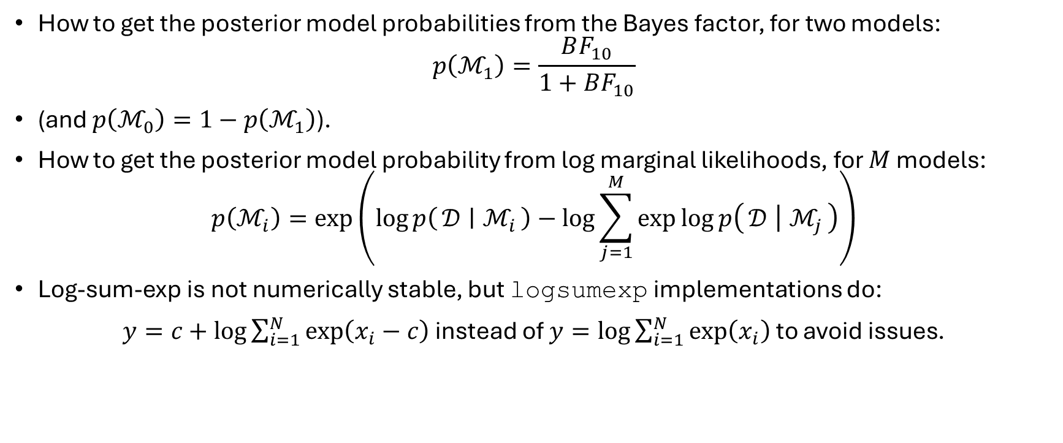
Some math identities
How to get the posterior model probabilities from the Bayes factor, for two models:
$$p\left(ℳ_{1}\right)=\frac{BF_{10}}{1+BF_{10}}$$
(and $p\left(ℳ_{0}\right)=1−p\left(ℳ_{1}\right)$).
How to get the posterior model probability from log marginal likelihoods, for $M$ models:
$$p\left(ℳ_{i}\right)=\exp\left(\log{p\left(𝒟 ∣ ℳ_{i}\right)−\log{\sum_{j=1}^{M}{\exp{\log{p\left(𝒟 ∣ ℳ_{j}\right)}}}}}\right)$$
Log-sum-exp is not numerically stable, but logsumexp implementations do:
$y=c+\log{\sum_{i=1}^{N}{\exp\left(x_{i}−c\right)}}$ instead of $y=\log{\sum_{i=1}^{N}{\exp\left(x_{i}\right)}}$ to avoid issues.

